Slide 1
Computer Vision
Part 2: Convolutional Neural Networks
ADF

Slide 2

Agenda
Part 1: Neural Network
Part 2: Convolutional Neural Networks
Computer Vision

Slide 3
Problems in Neural Network
2nd AI Winter
Computer Vision

Slide 4
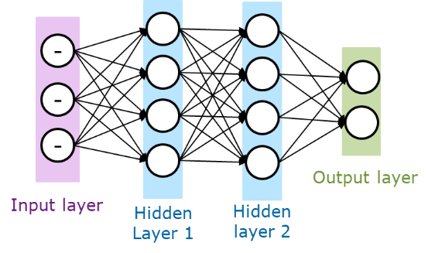
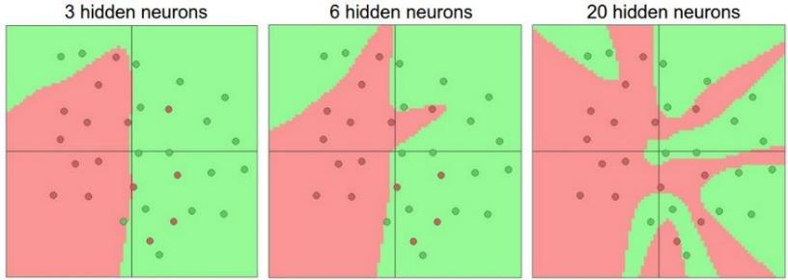
Review Layer Number and Size
more layers = more capacity
more neurons = more capacity
Computer Vision

Slide 5
Black Box Magic
Magically happen to performed well
It is difficult to know why a Neural Net made a particular decision,
or which data features where most important in making that decision
Computer Vision

Slide 6
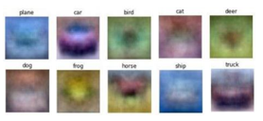
Black Box Magic
We know that linear classifier is like creating image template for each class
And each neuron in Multi Layered Perceptron is a linear classifier doing some classification
Computer Vision

Slide 7
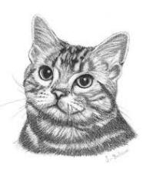




Black Box Magic
That’s why Neurons in Hidden layer are always described as sub-classifier which recognize features
Then the next neuron combines small features into larger features and continue further until the class classification
Computer Vision

Slide 8
Black Box Magic
The deeper the network, the more and more complex features are formed before reaching a decision
Or is it?
Computer Vision

Slide 9
Black Box Magic
The deeper the network, the more and more complex features are formed before reaching a decision
This description cannot be proven as only the first layer in Neural Network can be visualized
?
?
?
?
Computer Vision

Slide 10

Data Availability
The theory: with more data to learn, ANN can be trained further and became "smarter"
The problem?
Scarce data to train
Not enough storage
Computer Vision

Slide 11
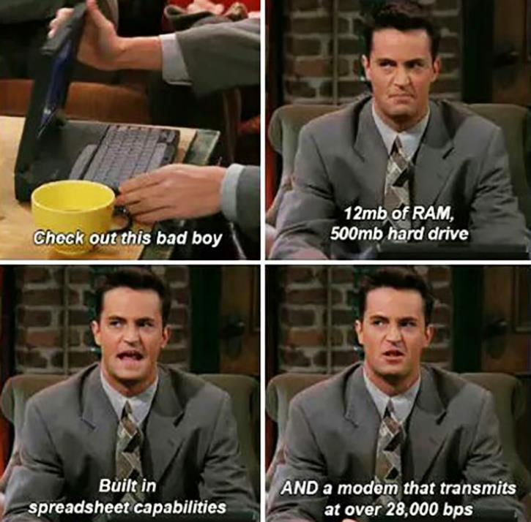
Computational Power
More data = longer training
1 high-end computer in 1993
≈ standard gaming rig 2007
≈ low-end laptop 2018
1 supercomputer in 1996
≈ GeForce GT 5x 2010
1 supercomputer in 2008
≈ TPU / high-end GPU 2018
Computer Vision

Slide 12
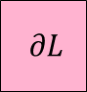
Back Propagation Problem
Activation matrix
Activation matrix
Activation matrix
resulting
Matrix loss
input
Layer 1 weight matrix
Layer 2 weight matrix
Layer 3 weight matrix
Layer $l$ weight matrix
$$∂L$$
Gradient matrix 1
Gradient matrix 2
Gradient matrix 3
Gradient matrix $l$
The Problem
happened here
Note: sigmoid functions produce small values in the range 0-1
Computer Vision

Slide 13
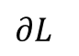
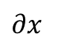
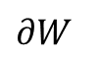
Vanishing Gradient Problem
Weight and
Activation cache
$$∂L$$
1e-2
1e-2
1e-6
1e-2
1e-4
1e-2
1e-2
$$∂x$$
$$∂W$$
~0
1e-8
1e-6
1e-4
Remember, Gradient is a feedback value that must be added to the weights so that loss can be reduced
Computer Vision
Notes:
Let the numbers in all caches and loss is in order of 1e-2
Then each backpropagation the number decreased

Slide 14

Vanishing Gradient Problem
The front layers can't learn (weights not updated)
It is said that the effective standard ANN is around 4 layers
Computer Vision

Slide 15
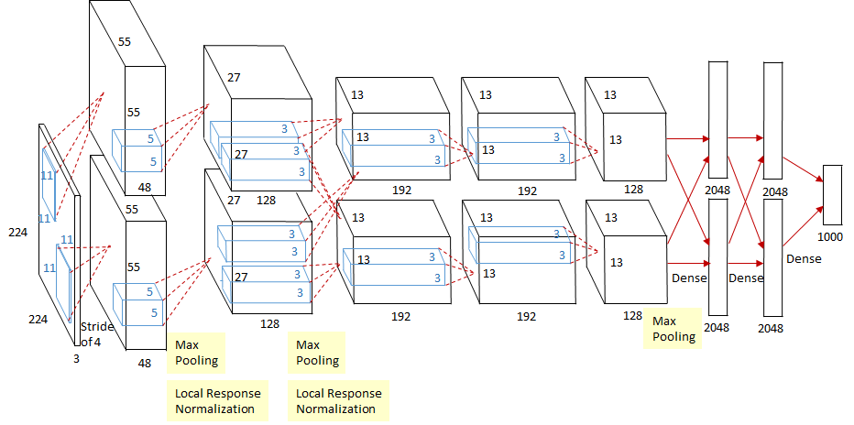
Serious Problem in Deep Networks
ConvNet: Millions of parameters
Gradient vanished in an instant
Computer Vision
Notes:
Performs parameter update for each training example

Slide 16
Deep Learning Arrival
Computer Vision

Slide 17
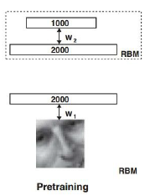
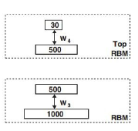
Layer-wise PreTraining
Do not train all layers in the network at once
Instead, train each layer one-by-one in unsupervised manner to build the feature extraction ability in stages
Computer Vision

Slide 18
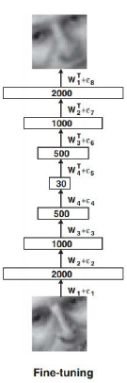
Layer-wise PreTraining
After all layers have been trained, merge the layers back into one classification network
First time backpropagation train properly in more than 10 layers with significant results
Hence the name:
DEEP LEARNING
Computer Vision

Slide 19
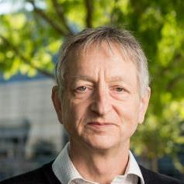

Deep Belief Network
Introduced by Geoffrey E Hinton and Russ Salakhutdinov in 2006
Using stacked Restricted Boltzmann Machine
The word Deep from DBN began to be popularized as Deep Learning
Computer Vision

Slide 20
Deep Belief Network
Reimagined and reinvigorated research in AI/ML
Most CS research came back to the area
Popularizing Deep Learning brand
Computer Vision

Slide 21
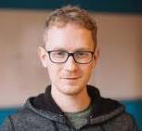


Dawn of ConvNet
Alex Krizhevsky, Ilya Sutskever, Geoffrey E Hinton, 2012
Imagenet classification with deep convolutional neural networks
Geoff Hinton began to be referred to by some as the "Godfather of Deep Learning“
Computer Vision

Slide 22
Deep Learning
Example: Shallow
autoencoders
Example: MLPs
Example: Logistic
regression
Example: Knowledge
bases
Representation Learning
Machine Learning
Artificial Intelligence
Computer Vision
Notes:
From Deep Learning Book by Ian Goodfellow, Yoshua Bengio, Aaron Courville

Slide 23
Machine Learning
Shallow | Deep
Neural Networks
boosting
Neural Net
perceptron
AE
D-AE
RNN
Conv. Net
SVM
Probabilistic Models
RBM
DBN
DBM
Sparse Coding
supervised
supervised
BayesNP
Gaussian
Mixture Models
ΣΠ
Decision Tree
unsupervised
Computer Vision

Slide 24
Convolutional Neural Network
Computer Vision

Slide 25
Layers in Convolutional Neural Network
3 Main Layers
Convolution Layer
Pooling Layer
Fully Connected
Common setting to use ReLU activation
after each Convolution Layer
after each FC Layer except the output Layer
Computer Vision

Slide 26

Computer Vision

Slide 27
Convolutional Layer
Computer Vision

Slide 28
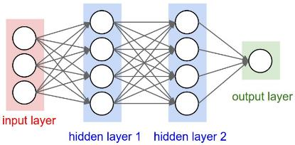
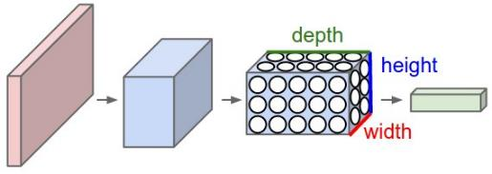
Regular NN and Convolutional NN
Regular Neural Net (affine layer) transforms (maps) an input vector (1-dimensional input) into an output vector (1-dimensional output)
ConvNet Layers transform
a 3-dimensional input into
another 3-dimensional output
Computer Vision
Notes:
A regular 3-layer Neural Network. Right: A ConvNet arranges its neurons in three dimensions (width, height, depth), as visualized in one of the layers. Every layer of a ConvNet transforms the 3D input volume to a 3D output volume of neuron activations. In this example, the red input layer holds the image, so its width and height would be the dimensions of the image, and the depth would be 3 (Red, Green, Blue channels).

Slide 29
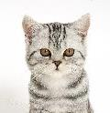
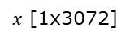
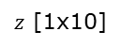
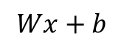
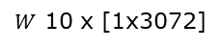
Fully Connected Layer
$$Wx+b$$
$x$ [1x3072]
[32x32x3]
$W$ 10 x [1x3072]
$z$ [1x10]
1 number:
the result of taking a dot product between a row of W and the input (a 3072-dimensional dot product)
Computer Vision

Slide 30
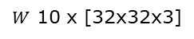
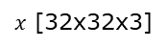
Fully Connected Layer
$$Wx+b$$
$x$ [32x32x3]
$W$ 10 x [32x32x3]
$z$ [1x10]
The Idea is:
Making whole image template
Computer Vision

Slide 31
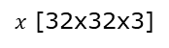

Fully Connected Layer
The input area that is connected to a neuron, is called the Neuron's Receptive Field
At the FC layer, each neuron is connected to all inputs
Global Connectivity
While on image input, the relationship between pixels (spatial correlation) is local
$x$ [32x32x3]
Computer Vision

Slide 32
Convolution Layer
32x32x3 image
32 height
5x5x3 filter
Now the receptive field of a neuron is local
This template is called Filter or Kernel
32 width
Create smaller template
3 depth
Computer Vision

Slide 33
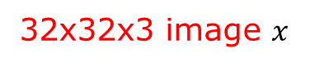
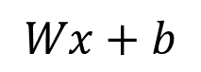
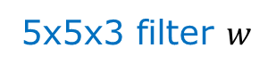
Convolution Layer
32x32x3 image $x$
5x5x3 filter $w$
32
$$Wx+b$$
32
Neuron activation:
the result of taking a dot product between the filter and a small chunk of the image
(i.e. 5*5*3 = 75-dimensional dot product + bias)
3
Computer Vision

Slide 34
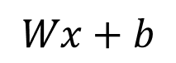
Convolution Layer
32x32x3 image $x$
Activation Map
5x5x3 filter $w$
32
$$Wx+b$$
28
convolve (slide) over all
possible spatial locations
32
28
1
3
Shared Weights:
Each output in the activation map is calculated from the same weight matrix
Computer Vision
Notes:
Activation map = the responses of the corresponding filter for all location spatially (at every single spatial position)

Slide 35
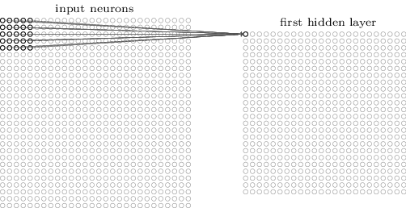
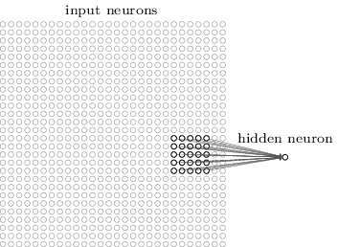
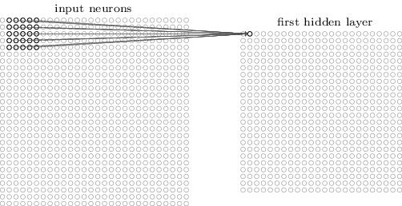
Convolution Layer
Computer Vision
Notes:
Activation map = the responses of the corresponding filter for all location spatially (at every single spatial position)

Slide 36

Illustration
1 | 0 | 1
0 | 1 | 0
1 | 0 | 1
Filter weight
Computer Vision

Slide 37
Convolution Layer
Activation Map
Indicates the responses of the corresponding filter for all location spatially
32
$$Wx+b$$
28
convolve (slide) over all
possible spatial locations
32
28
1
3
A filter creates a small feature template,
Activation value indicates the presence of that feature in that particular location
Computer Vision
Notes:
Activation map = the responses of the corresponding filter for all location spatially (at every single spatial position)

Slide 38
Convolution Layer
32x32x3 image
Multiple Filter for each layer
32
@ 5x5x3 filter
32
3
Each filter is convolved independently
The Idea is: Making many small-templates
Computer Vision

Slide 39
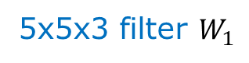
Convolution Layer
32x32x3 image $x$
Activation Map
5x5x3 filter $W_{1}$
32
First Filter
28
convolve (slide) over all
possible spatial locations
32
28
1
3
Computer Vision
Notes:
We’ll have an entire filter bank

Slide 40
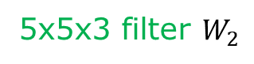
Convolution Layer
32x32x3 image $x$
Activation Map
5x5x3 filter $W_{2}$
32
Second Filter
28
convolve (slide) over all
possible spatial locations
32
28
1
3
Compute independently
Computer Vision
Notes:
We’ll have an entire filter bank

Slide 41
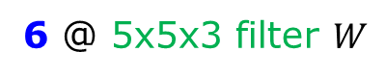
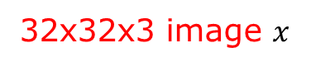
Convolution Layer
32x32x3 image $x$
Activation Map
32
28
32
6 @ 5x5x3 filter $W$
28
3
6
Computer Vision
Notes:
We’ll have an entire filter bank

Slide 42
Convolution Layer
32x32x3 image $x$
Activation Map
New Image of [28x28x6]
32
28
Next Layer
32
6 @ 5x5x3 filter $W$
28
6
3
Computer Vision
Notes:
We’ll have an entire filter bank

Slide 43
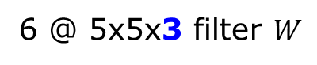
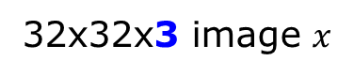
Convolution Layer
32x32x3 image $x$
Activation Map
New Image of [28x28x6]
32
6 @ 5x5x3 filter $W$
28
Next Layer
32
28
6
3
Computer Vision
Notes:
We’ll have an entire filter bank

Slide 44
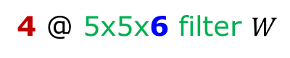
Convolution Layer
Activation Map
2nd Activation Map
New Image of [28x28x6]
New Image of [24x24x4]
28
6
5
24
5
4 @ 5x5x6 filter $W$
24
28
4
6
Computer Vision
Notes:
We’ll have an entire filter bank

Slide 45
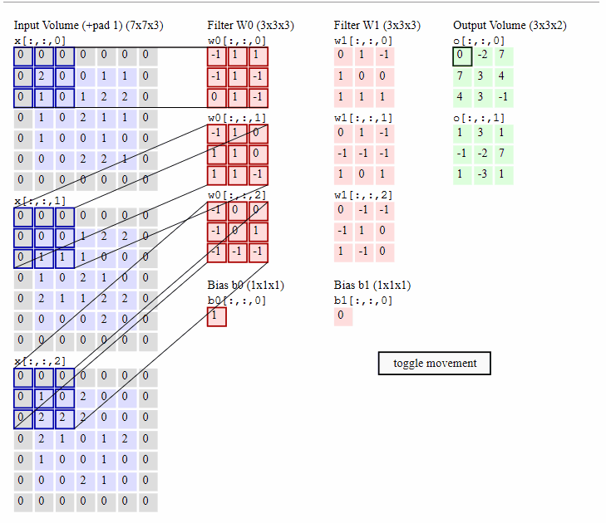
Computer Vision
Notes:
http://cs231n.github.io/convolutional-networks/

Slide 46
Local Connectivity Pattern
Computer Vision

Slide 47
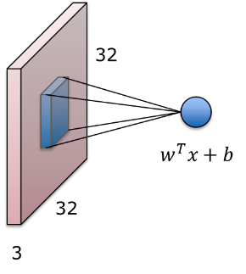

Local Connectivity Pattern
32x32x3 image
Each neuron target a specific portion (input part)
In the example, Neuron’s Receptive field is 5x5
5x5x3 filter $w$
Computer Vision

Slide 48
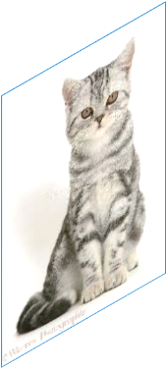
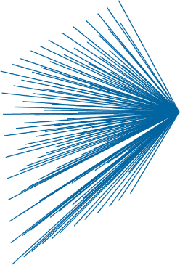
Fully Connected Neural Net
Example:
32x32x3 image
1000 neuron:
32 x 32 x 3 x 1000 parameters
3,072,000 parameters
Spatial correlation in local
Better put resources elsewhere
Computer Vision

Slide 49


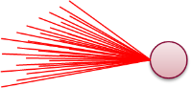
Locally Connected Neural Net
Example:
32x32x3 image
1000 neuron, filter size 4x4x3:
4 x 4 x 3 x 1000 parameters
48,000 parameters
Problem: Stationarity
Prone to overfitting
Computer Vision

Slide 50
Convolutional Neural Net
Example:
32x32x3 image
100 filters, filter size 4x4x3:
4 x 4 x 3 x 100 parameters
4800 parameters
Learn multiple filters
Computer Vision

Slide 51
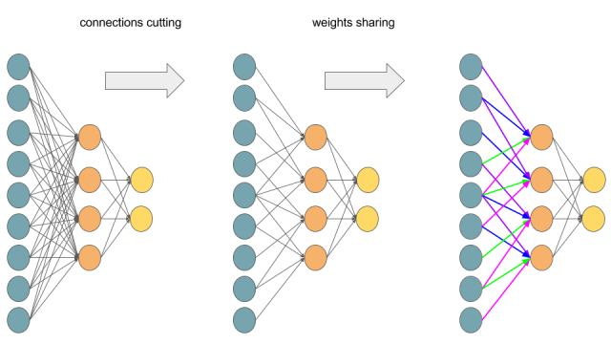
Transforming Multilayer Perceptron to Convolutional Neural Network
Computer Vision

Slide 52
Local Receptive Field (Sparse Connectivity)
Convolution exploits the property of spatial local-correlations in the image by enforcing local connectivity pattern between neurons of adjacent layers
Drastic reduce in the number of free parameters compared to fully-connected network
Reducing overfitting and –more importantly– computational complexity of the network
Computer Vision

Slide 53
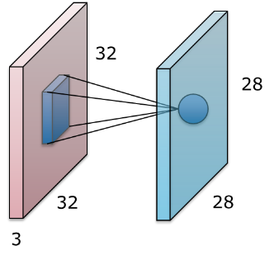
Shared Weight
Activation map
28x28 sheet of neuron outputs
Each is connected to a small region in the input
All of them share parameters
For 5x5 filter
5x5 receptive field for each neuron
Computer Vision

Slide 54
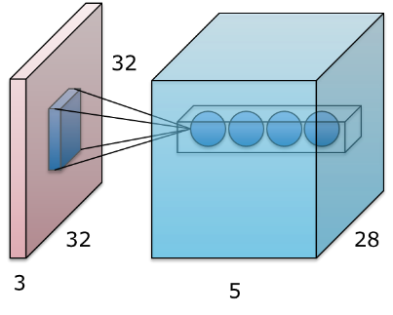
Different ways of observing each part
Activation maps (volume)
E.g. with 5 filters,
Conv layer consists of neurons arranged in a 3D grid (28x28x5)
There will be a result of 5 different neurons all looking at the same region of the input
Computer Vision
Notes:
Controlling capacity of the models → each neuron compute the same thing spatially, like finding an edge in all location
Example, 1 filter will search for a vertical bar in all across space

Slide 55
Different ways of observing each part
Control overfitting
Each filter will try to match a single feature in all spatial position
Contrast in full global connectivity
Too much parameter
Computer Vision
Notes:
Controlling capacity of the models → each neuron compute the same thing spatially, like finding an edge in all location
Example, 1 filter will search for a vertical bar in all across space

Slide 56
Pooling Layer
Computer Vision

Slide 57
Pooling - Motivation
Let’s say we have a filter which is an "eye" detector
Positive activation indicates the presence of "eye"
The filter is activated the moment an eye image enters the receptive area
How to make the detection robust to the exact location of the eye?
Computer Vision
Notes:
1 number: the result of taking a dot product between the filter and this part of the image

Slide 58
Pooling - Motivation
Pooling Layer filters and collects responses in neighboring locations
Obtain general area of ​​neuron activity
Gain robustness to the exact spatial location of features
Computer Vision
Notes:
1 number: the result of taking a dot product between the filter and this part of the image

Slide 59
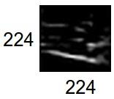
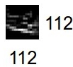
Pooling Layer
Effectively, the job of the pooling layer is to shrink the size of the activation map
Performs downsampling on spatial size, but not depth
Each activation map is down-sampled separately
224x224x64
112x112x64
pool
downsampling
Computer Vision
Notes:
progressively reduce the spatial size of the representation to reduce the amount of parameters and computation in the network

Slide 60
Pooling Layer
224x224x64
112x112x64
pool
Intended to reduce the representation size
Easier to use and manage
Control overfitting
Computer Vision
Notes:
progressively reduce the spatial size of the representation to reduce the amount of parameters and computation in the network

Slide 61
Conv vs Pool
224x224x32
224x224x64
112x112x64
112x112x96
conv
pool
conv
Preserve the spatial size when performing convolution, but increase (or decrease) the depth of the activation
Shrink the spatial size when pooling, but maintain the activation depth (number of features)
Computer Vision
Notes:
progressively reduce the spatial size of the representation to reduce the amount of parameters and computation in the network

Slide 62
Max and Average Pooling
The Pooling Layer combines the activation in a local area then passes it on to the next layer
Max Pooling
Average Pooling
15 | 9 | 4 | 2
11 | 5 | 8 | 6
8 | 7 | 3 | 17
2 | 3 | 7 | 3
15 | 8
8 | 17
10 | 5
5 | 8
Max Pooling
Average Pooling
Computer Vision

Slide 63
CNN are Everywhere
Computer Vision

Slide 64
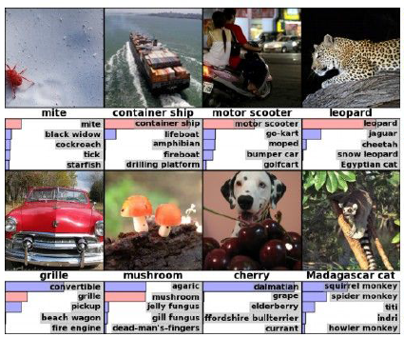

Today : CNN are everywhere
Classification
Retrieval
[Krizhevsky 2012]
Computer Vision

Slide 65


Today : CNN are everywhere
Detection
Segmentation
[Faster R-CNN: Ren, He, Girshick, Sun 2015]
[Farabet et al., 2012]
Computer Vision

Slide 66


Today : CNN are everywhere
Self Driving Car
Video classification
Computer Vision

Slide 67


Today : CNN are everywhere
Pose estimation
[Taigman et al., 2014]
Playing computer games
[Simonyan et al., 2014]
Computer Vision

Slide 68


Today : CNN are everywhere
Cancer cell detection
[Ciresan et al., 2013]
[Rakhlin, et al., 2018]
Computer Vision

Slide 69


Today : CNN are everywhere
Chinese character recognition
Japanese Ancient Kanji
Character recognition
Computer Vision

Slide 70


Today : CNN are everywhere
Text processing
[Denil et al., 2014]
Speech processing
Computer Vision

Slide 71


Today : CNN are everywhere
routes optimization
Whale Recognition, Kaggle Competition
[Mnih and Hinton, 2010]
Computer Vision

Slide 72

Today : CNN are everywhere
[Karpathy and Fei-Fei, 2015]
[Vinyals et al., 2010]
Computer Vision

Slide 73





Computer Vision

Slide 74

Question?
Computer Vision

Slide 75

Next Agenda
Image Processing Techniques
Modern Computer Vision Techniques
Computer Vision

Slide 76
References
Fei-Fei Li, Andrej K, Justin J - Stanford CS231n 2016 Course
Fei-Fei Li, Justin J, Serena Y - Stanford CS231n 2018 Course
Grauman, K. and Leibe, B. 2011. Visual Object Recognition. Synthesis Lectures Artif. Intell. Mach. Learn. 5, 1 181
Computer Vision

